Slide 1
Deforestation
Visualisation
Rowan, Min & Hien

Slide 2
Topic Background
Through our project, we are attempting to visualise the change in our environment due to the increase of deforestation over time.
Our research question is: How has the extent and nature of deforestation evolved over the last century, and will there be trends to help understand our future?
We are highlighting our blurred understanding of deforestation and its vast impact, attempting to elaborate on its importance through a mixture of engaging visualisation and written theoretical text.
Deforestation is an understanding that majority may have, but our attempt with this project is to provide further context through the mixture previously mentioned.
For example, 9 in 10 people are aware of deforestation in the Amazon rainforest - where else? Is it just as well known that Russia’s rate of deforestation is higher than Brazils? (80.3m hectares of loss form 2001-2022 vs Brazil’s 66.1m hectares)
We hope this encourages more eco-friendly behaviours.

Slide 3
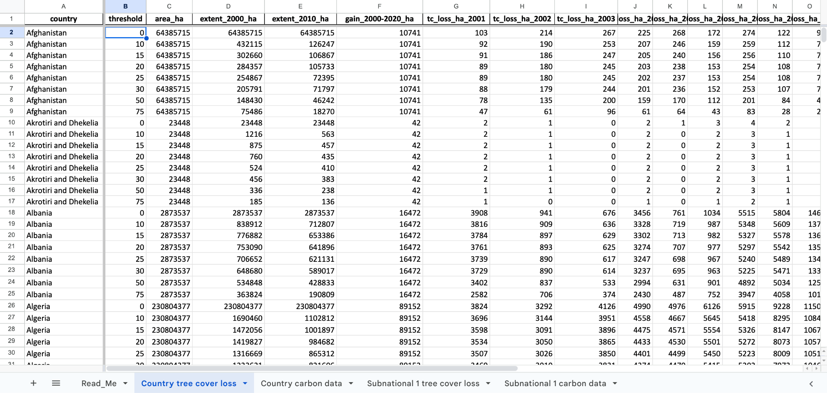
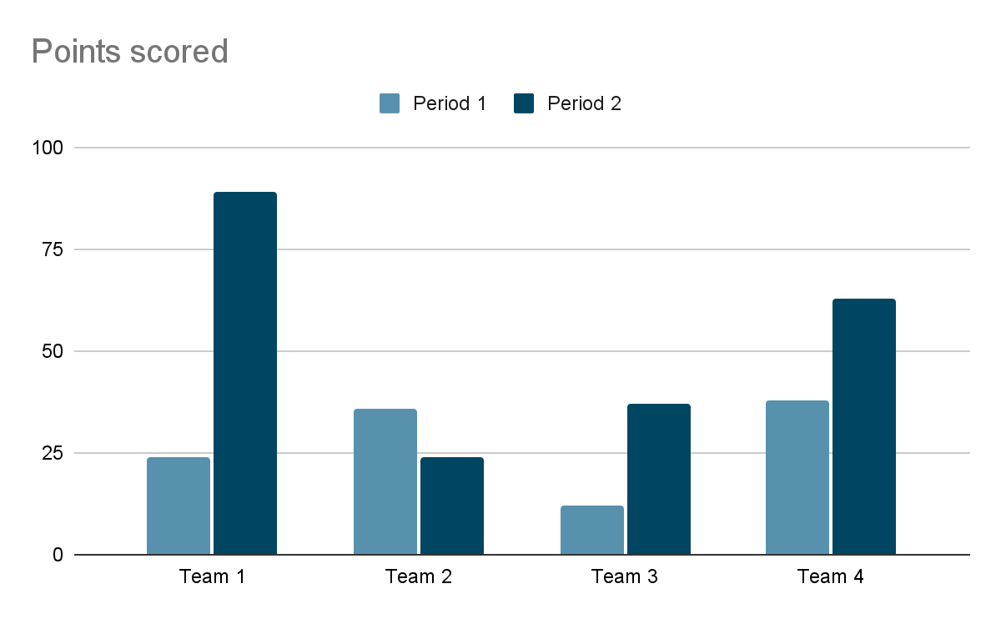
Dataset
World Resource Institute–Global Forest Watch
TIME
Why is the chosen year/time period important?
COUNTRY
Underlying political concerns? Why were these countries chosen?
AREA
What is the main driver of deforestation in this area? Is the area loss permanent?
Hectares of tree cover loss at a national level, between 2001-2022
Notes:
https://research.wri.org/gfr/data-methods
https://www.globalforestwatch.org/dashboards/global/?location=WyJnbG9iYWwiXQ%3D%3D
Data available as annual average.
Tree cover available for 2000 and 2010 as point of reference for other years.
Data from University of Maryland’s Global Land Analysis and Discovery laboratory in partnership with google.
Obtained from geospatial data, computer algorithms and cloud computing.
In this data set, “tree cover” is defined as all vegetation greater than 5 meters in height, and may take the form of natural forests or plantations across a range of canopy densities. “Loss” indicates the removal or mortality of tree cover and can be due to a variety of factors, including mechanical harvesting, fire, disease, or storm damage. As such, “loss” does not equate to deforestation.
Hansen, M.C., P.V. Potapov, R. Moore, et al. 2013. "High-Resolution Global Maps of 21st-Century Forest Cover Change." Science 342: 850–53. Data available on-line from: https://glad.earthengine.app/view/global-forest-change.

Slide 4
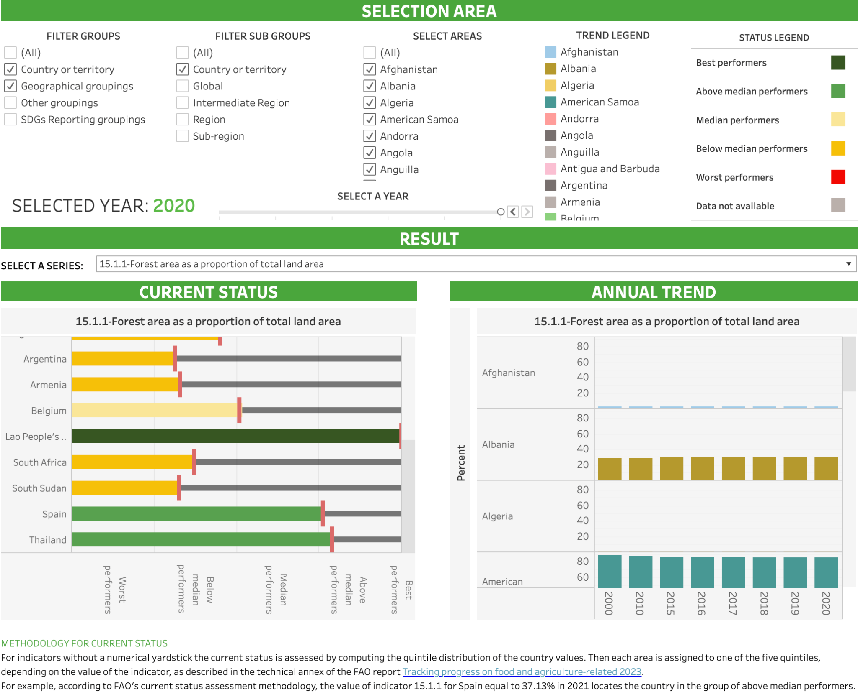
Dataset
United Nations–Food and Agriculture Organisation (FAO)
Forest area as a percentage of total land area, 2015-2020
Notes:
https://www.fao.org/statistics/data-collection/forestry/en#navbarNavWebsite
https://unstats.un.org/sdgs/dataportal
https://unstats.un.org/sdgs/dataContacts/ (Filter to FAO at the Agency drop-down)
https://www.fao.org/sustainable-development-goals-data-portal/data/
https://www.fao.org/sustainable-development-goals-data-portal/data/indicators/indicator-1511---forest-area-as-a-percentage-of-total-land-area/en (THIS ONE)
This indicator measures the proportion of the world's land area that is forested and is expressed as a percentage. Changes in forest area reflect changes in demand for land for other uses and may help in identifying unsustainable practices in the forest and agriculture sectors.

Slide 5
Dataset
Points of Contact
World Resource Institute
Elizabeth Goldman
elizabeth.goldman@wri.org
Food and Agriculture Organisation
Forestry Officer: Anne Branthomme
anne.branthomme@fao.org
+39 06570 53055
Programme Advisor: Dorian K. Navarro
doriankalamvrezos.navarro@fao.org
+39 06570 54500
Notes:
https://research.wri.org/gfr/data-methods
https://www.globalforestwatch.org/dashboards/global/?location=WyJnbG9iYWwiXQ%3D%3D
https://www.fao.org/statistics/data-collection/forestry/en#navbarNavWebsite
https://unstats.un.org/sdgs/dataportal
https://unstats.un.org/sdgs/dataContacts/ (Filter to FAO at the Agency drop-down)

Slide 6
Critique of the Dataset/Project
Discrepancies surrounding the various ‘types’ of deforestation
While there is a set understanding, there are no set guidelines as to what counts as deforestation. Some (over a third) is considered ‘legal’ (but even those are laws that allow it are created by private, biased organisations), other types of deforestation is ‘temporary’. There is constant bias within this all.
Variations in Data (Uncertainties in deforestation emission baseline methodologies and implications for carbon markets)
“The median jurisdiction’s deforestation emission baseline varied by 171% (90% range: 87%-440%) of its mean, with a median forecast error of 0.778 times (90% range: 0.548-3.56) the actual deforestation rate" (Teo et al. 2023:2)
“Deforestation emission baselines vary considerably depending on the methods and parameters used, within the range of commonly permissible methods and parameters" (Teo et al. 2023:5)
Balancing the Aesthetics of Visual Unity vs the Aim to Answer the Question (Isotype: representing social facts pictorially)
Isotype mentioned various elements that make up ‘The Vienna Method’ such as simplification,
repetition, and an education focus
“To remember simplified pictures is better than to forget accurate figures” implies that there must be a complete balance in order to answer our question correctly.
-
-

Slide 7
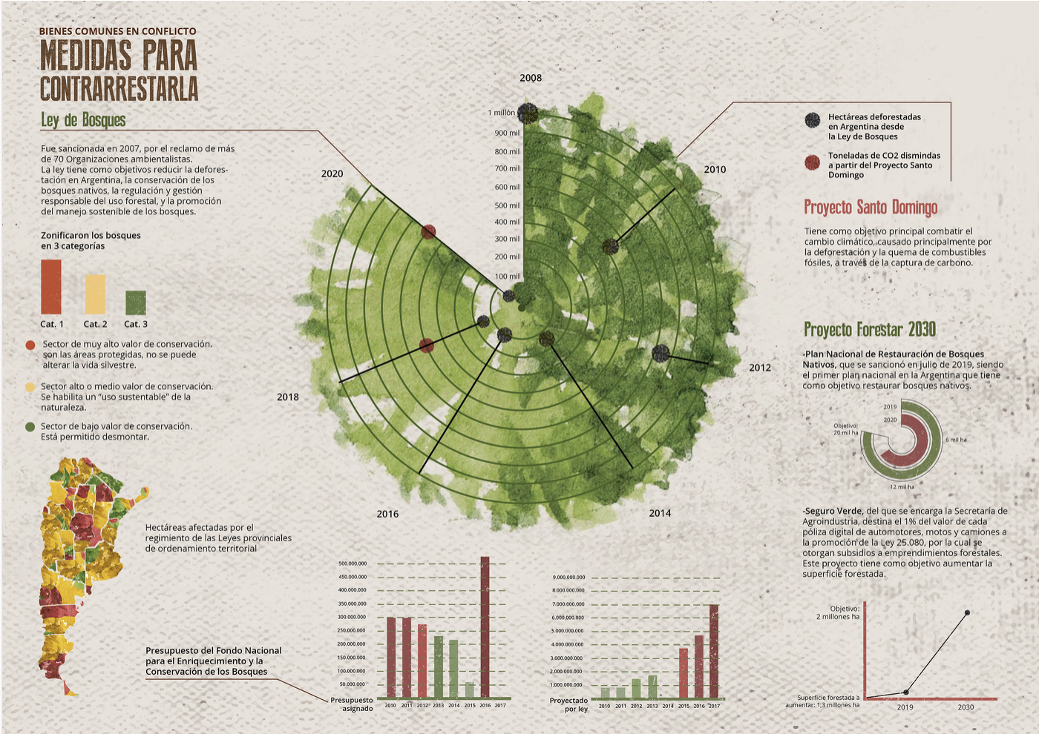
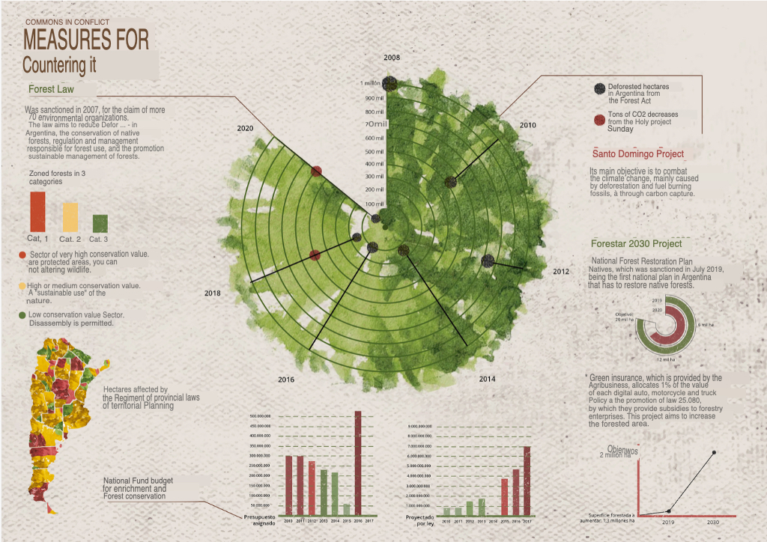
Inspiration Case Study
cindyrvogel@gmail.com
nzacoski@gmail.com
Zacoski and Vogel (2021) ‘Deforestación Argentina - Infografía’. Behance, 11 Feb. Available at: https://www.behance.net/gallery/113285427/Deforestacion-Argentina-Infografia (Accessed on Saturday 9 March 2023)

Slide 8
Visualisation
Graphs and Iconography
01
Tree Stump
The dataset from the ‘World Resource Institute lists the hectares of tree cover loss at a national level, between 2001-2022. As inspired by the previous graph, our primary graphic will be a tree stump. The rings will indicate the rapid rate of tree loss, with the outer ring (point 1) illustrating the tree coverage in 2001, to the inner rings (point 4) demonstrating the present day, with data as recent as 2022.
04
03
02

Slide 9
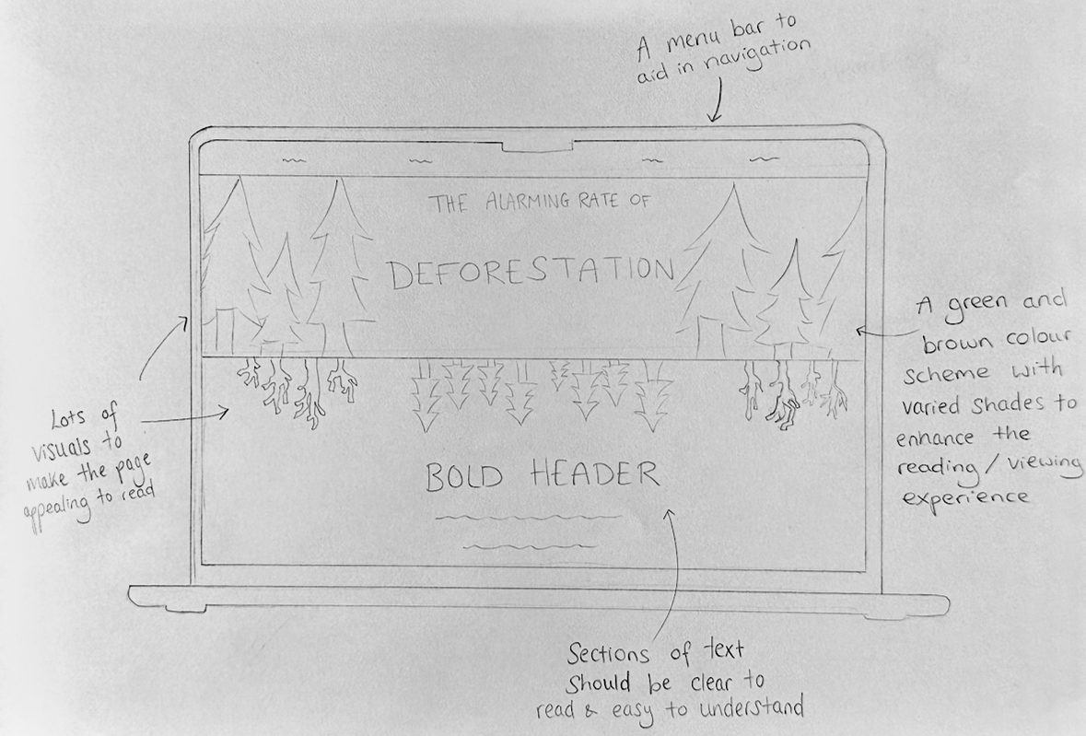
Layout and Navigation

Slide 10
Project Timetable
Who’s doing what?
We will communicate to work fairly and collaboratively, however, we also intend to play to our strengths and interests by assigning a leader for each area of work
 | ROWAN | MIN | HIEN
Data
Writing
Design and Graphics
Navigation/ Accessibility
Code
The coding will be a collaborative effort and learning curve, since none of us are confident in that area.

Slide 11
Possible Issues
What struggles might we encounter?
01
02
Technical Ability
Human Error
We aren’t the most confident with coding.
Errors in the writing, data collection or coding
03
04
Data Discrepancies
Ethical Consideration
Possible issues to do with data accuracy or even availability due to bias and varied data collection
This project should not be sensationalist and exploitative of communities nor the issue itself. Rather, it should be informative over the matter of deforestation and gather the right attention

